Slide 1
Grocery Management System
KK MART

Slide 2
Group Members:
Muhammad Hassaan Raza 22-NTU-CS-1362
Kanza Kashaf 22-NTU-CS-1350

Slide 3
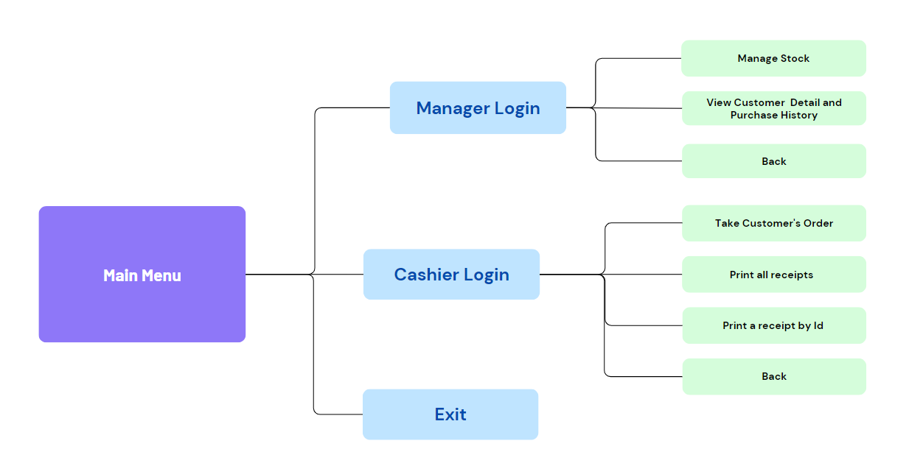
Flow Chart

Slide 4
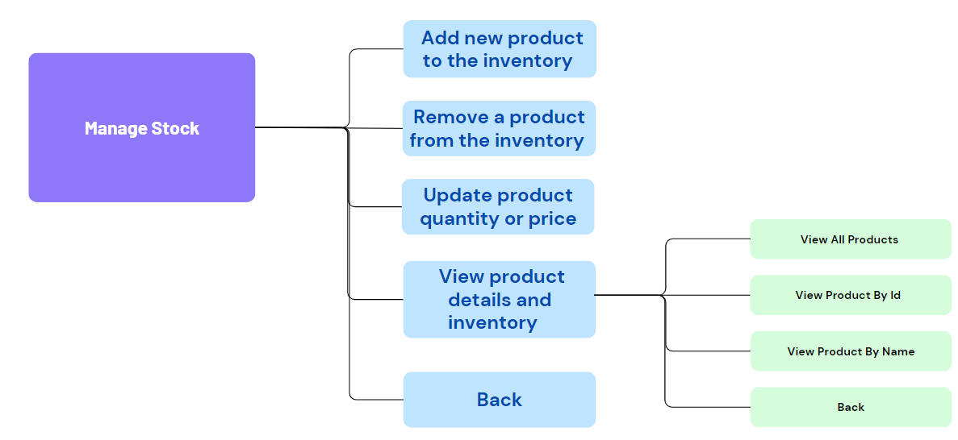
Manager Login

Slide 5
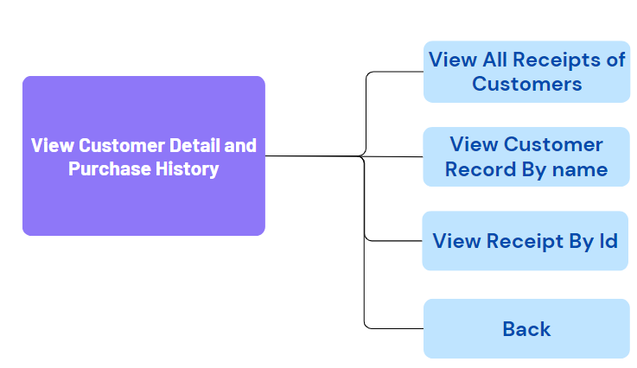
Manager Login

Slide 6
Work Division
Tasks Done Together:
Linked List Class Implementation
Creating, Removing, Updating, Deletion in Linked List class
Helping Functions
Quantity available
Searching an item(Product, Receiept)
Muhammad Hassaan Raza (1362):
File Handling
Flow Chart
Kanza Kashaf (1350):
Display Functions
Menus
PPT

Slide 7
Thanks!!

